Slide 1
Classroom
Learning Management System

Slide 2

Master of Computer Application (2020-2022)
MAJOR PROJECT FOR SEMESTER 4
Under the guidance of
Dr. Shiladitya Chowdhury
Assistant Professor,
Dept. of MCA,
Techno Main Salt Lake

Slide 3
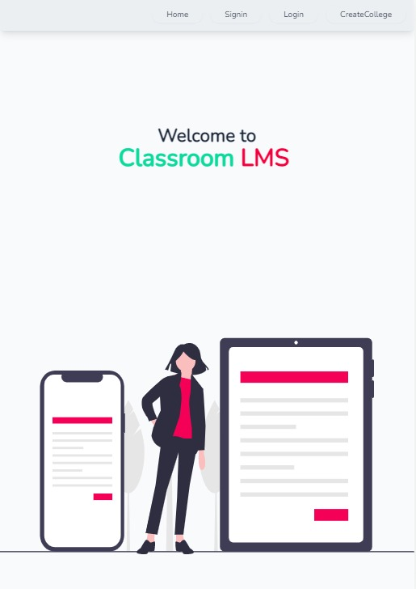
Project Team -
Name | Roll no.
Pritam Chakraborty | 13071020030
Tathagata Das | 13071020017
Rimi Mondal | 13071020016
Priyesh Ghosh | 13071020060
Akanksha | 13071020044
Rivu Pal | 13071020032
(Group No: 710202102)

Slide 4
Today’s Topics
Introduction
System Requirements
Why Classroom LMS
Modules
Goal of the project
UML & ER Diagram
Objectives
Future Scope
Scope of the project
Conclusion

Slide 5
INTRODUCTION
A classroom means there will be a collection of students and teachers, and who will have permission to enter which classroom, will be decided by the higher authority which means the admin.
This era is the era of virtualisation, paperless work and era of connectivity.
That's why we have developed a virtual classroom which is a learning management system that can be used by colleges for the time being.
Our Classroom LMS is also the virtual collection of students, teachers and admins.

Slide 6
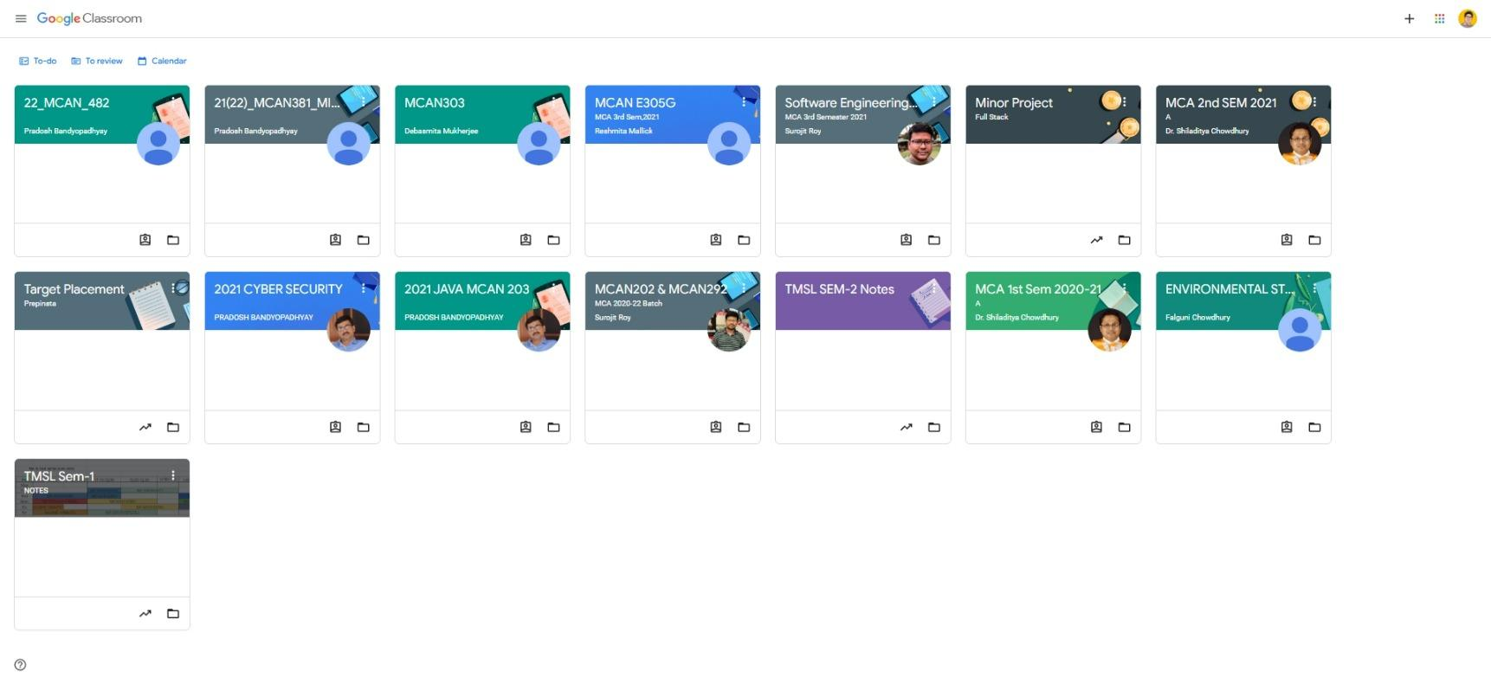
Why Classroom LMS?
Subjects Grouped By Sem?
Grouped Notes & Assignments.
Overhead of link sharing and Exposing the classroom to
unknown people

Slide 7
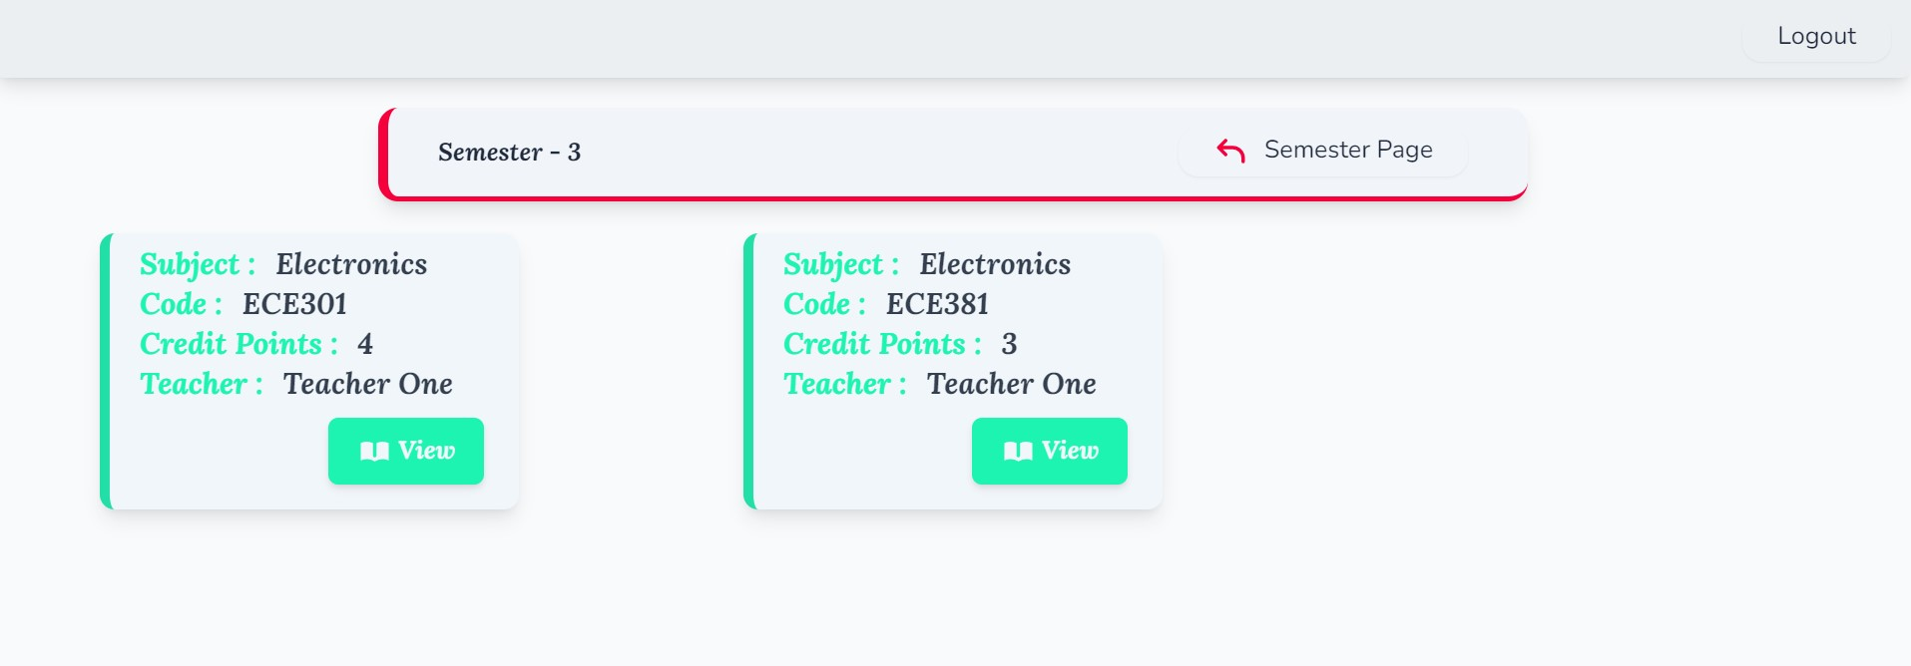
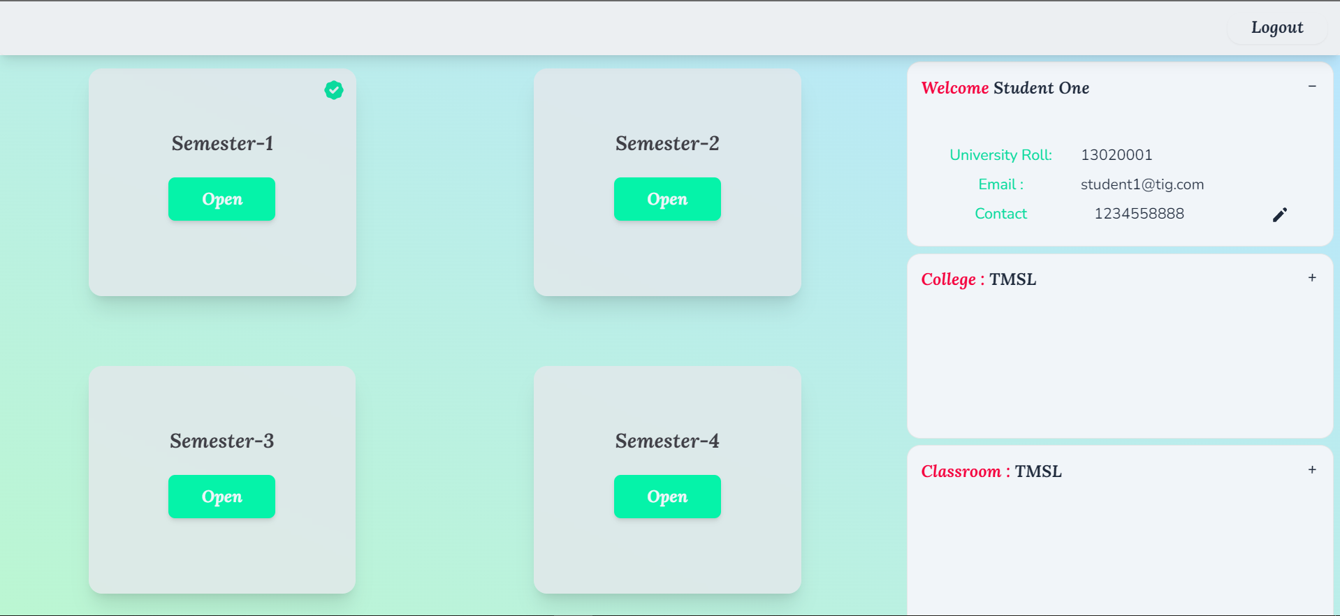
Why Classroom LMS?
Subjects inside semester
Looks Organized right?
Dashboard for a Student

Slide 8
Goal of the project
To build a virtual classroom environment which is
Much more organized
User friendly and focused UI
No Link sharing hazard
Admin manages classrooms so no overhead for teacher
Student can view all organized notes of previous sem for better preparation

Slide 9
Objectives
6.
1.
Teachers & Students focus on their work via their dashboard respectively
Owner creates virtual college
2.
5.
Owner manages Other DBA & Teachers for institution through admin panel
Teachers , Students, & DBAs can do one time signup and then can login
3.
4.
Map DBA to particular stream(s)
DBA creates & manages classroom & related teachers and students

Slide 10

Classroom LMS
DBA
Create college
Owner
Way
To the
Classroom
Teachers
Students
Classroom

Slide 11
Upload notes assignments
Download notes , View assignments
Teacher
Students
View Submissions & grade students
Upload assignments
How it works

Slide 12
The Scope of The Project !

Slide 13
Our project gives 3 layer facility to the user
Administration Accessibility :
Owner has scope to create virtual college.
Owner can add any other dba or teacher to college and manage them. Also can add new stream.
Owner and DBA manage classroom, assign teacher and students which gives the administrators a flavor like offline situations.

Slide 14
Teacher Accessibility :
Teachers can only view the particular classes he/she is assigned to.
A teacher can create his/her subjects in the classroom.
Upload notes, quick announcements and assignments there.
Grade the assignments uploaded by students.

Slide 15
Student Accessibility :
Students are assigned to the class by the DBA.
Able to see all the semesters of their course
view announcements, to download notes, to upload assignments one-time each.
Check feedback and results graded by teacher.
They can edit their contact details after their login/registration.

Slide 16
System Requirements

Slide 17








Developer Side
Softwares
Hardwares
Operating System : Windows 10
Web Browser: Chrome 102.0.5005.115
Front End: HTML5, Tailwind CSS 3.0.24
Vue. js 3.2.33, Heroicons 1.0.6
Axios 0.27.2, Vue-router 4.0.14
Back End:
Python 3.10.4 , Django 4.0.3, Database:- MySQl 8,Celery,Redis 7.0 , Docker 19.03
 | Type | Quantity
Memory | RAM | Min - 4 GB
Storage | SSD | 100GB
CPU | I5-11th Gen | -

Slide 18

Client Side
Web Browser:
Chrome
Version: 102.0.5005.115
Microsoft Edge
Version: 102.0.1245.39

Slide 19

Modules
Admin
Owner
DBA
Teacher
Student

Slide 20

Owner
Module

Slide 21
Creates a virtual college in Classroom LMS
Has ownership of college
Adds DBA to each stream in the college
Lead of all DBAs and has same privileges of DBA

Slide 22
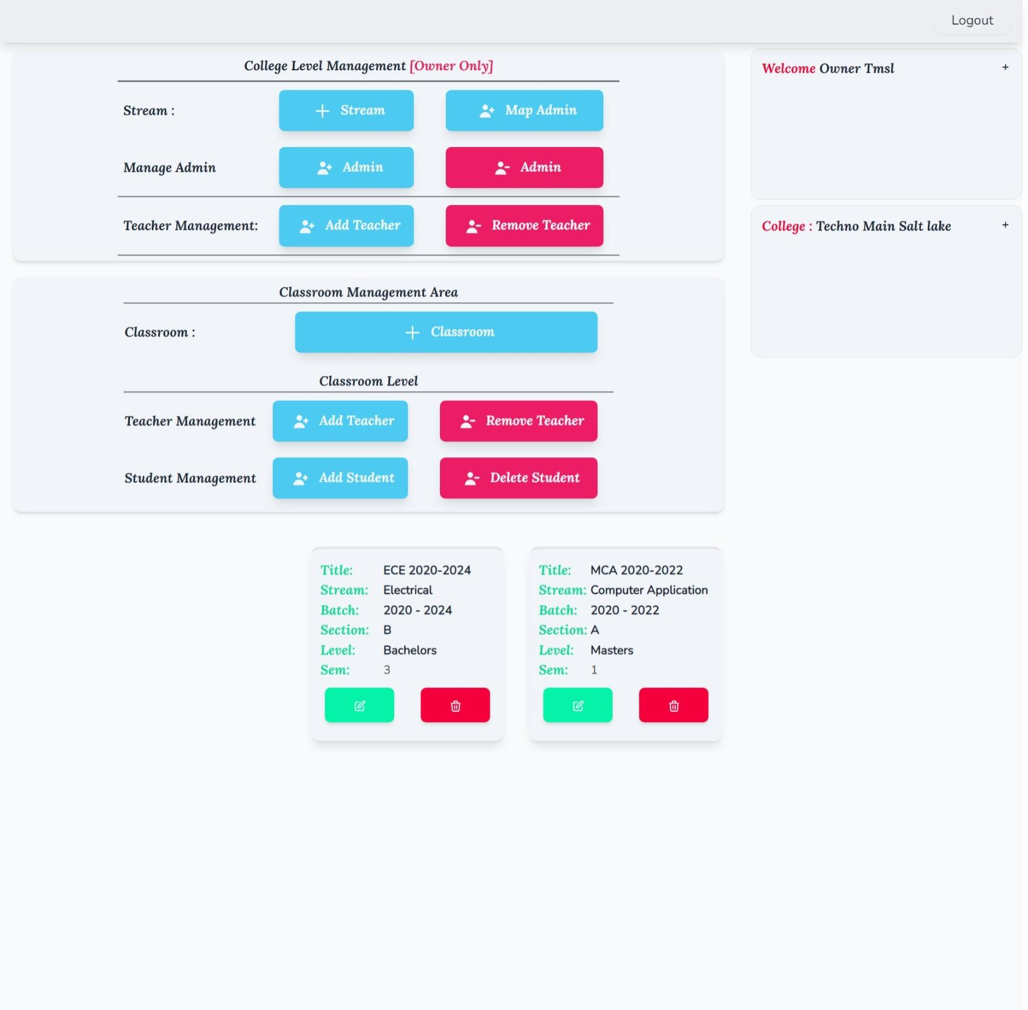
Owner Dashboard

Slide 23
DBA
Module

Slide 24
Manages classroom and provide constant moderation
Assigns Teacher and Students to their respective Class
Adds or Removes Class ,Updates Current Sem
Adds or Removes Teacher and Students from classroom

Slide 25
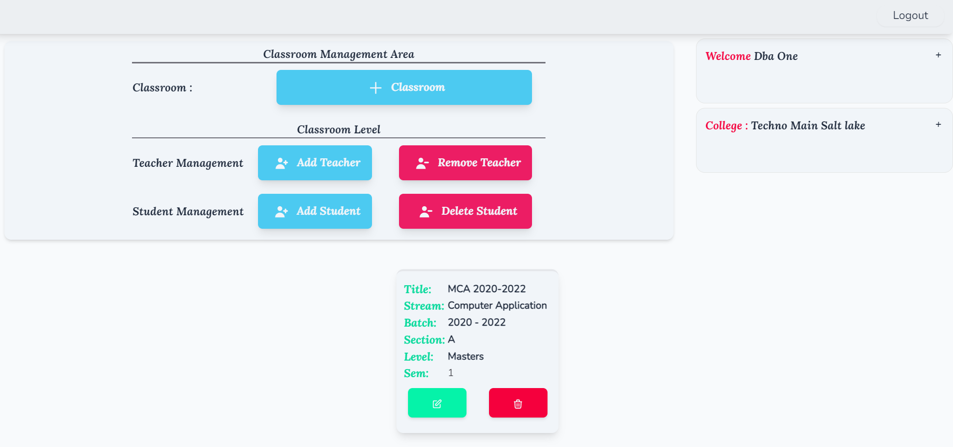
DBA Dashboard

Slide 26
Teacher
Module

Slide 27
Teacher can create and edit his/her subjects in the classroom.
Teachers can upload notes
Post quick announcements
Post assignments and provide grades respectively .
Teachers Can Provide Feedbacks .

Slide 28
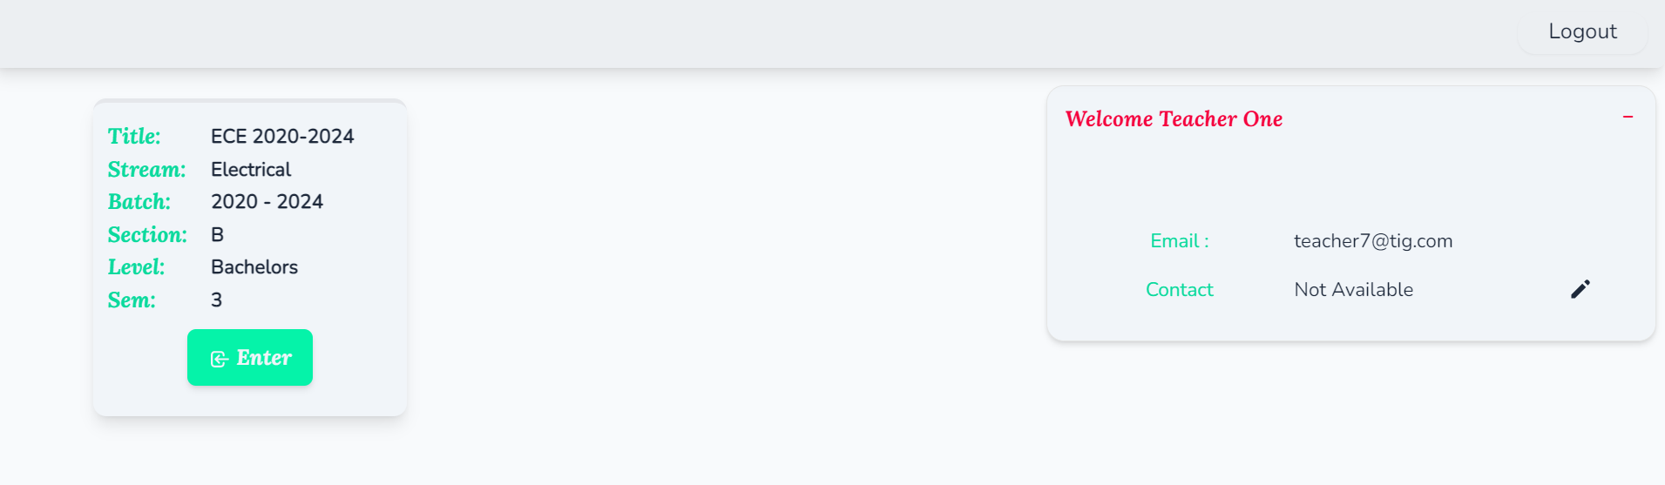
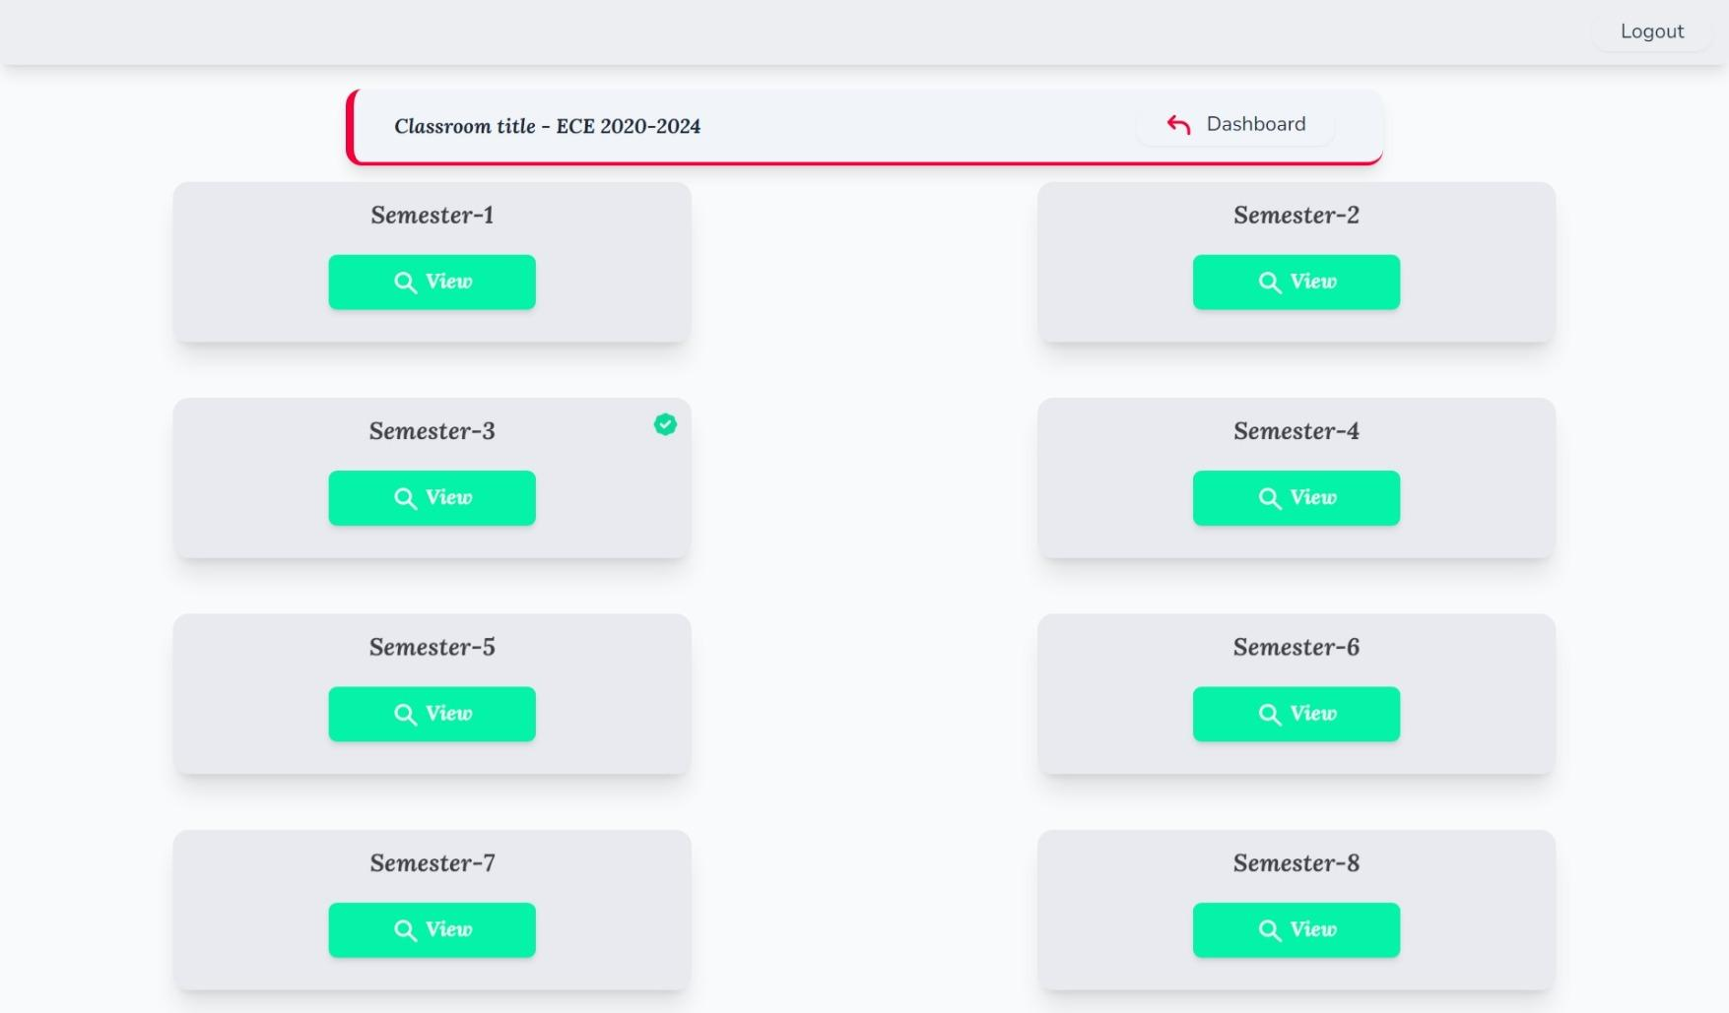
Teacher Dashboard

Slide 29
Student
Module

Slide 30
Students can access all the semester materials of their courses
Has privilege to view announcements, download notes, upload assignments one-time each.
Can view assignment results and teachers feedback

Slide 31
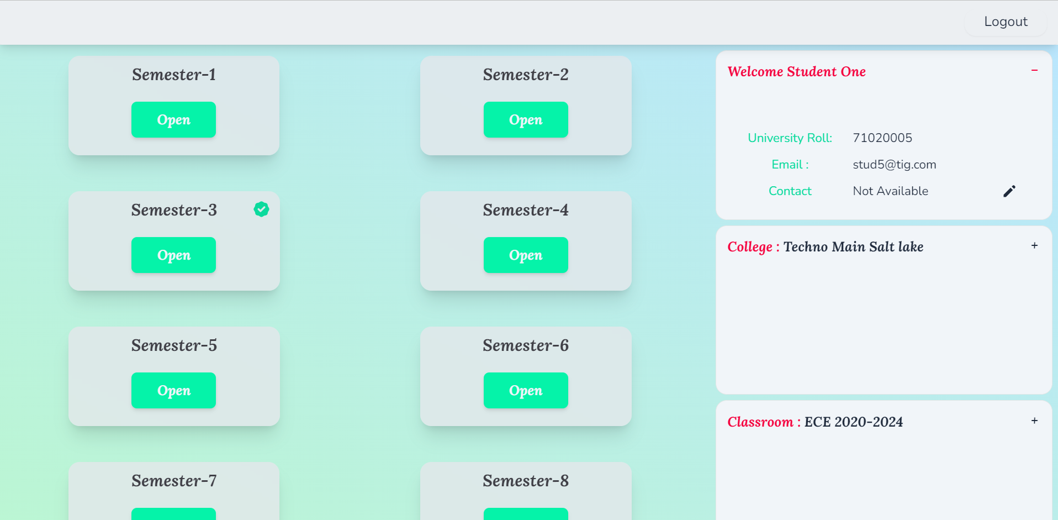
Student Dashboard

Slide 32
UML DIAGRAM

Slide 33
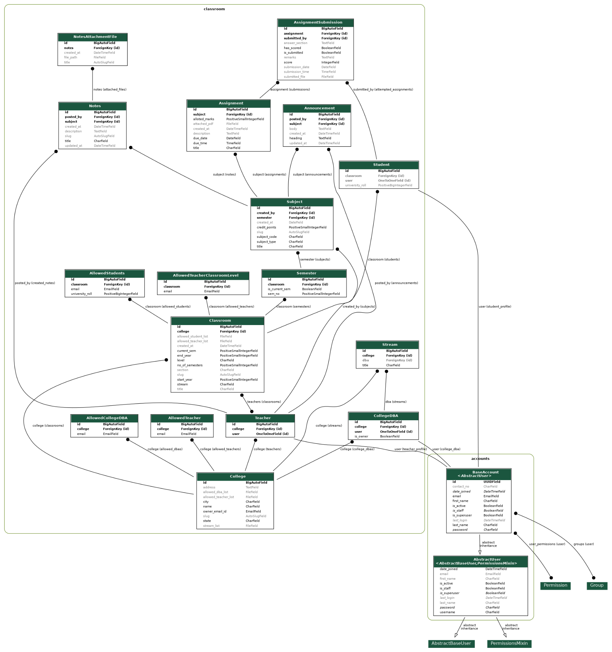

Slide 34
ER DIAGRAM

Slide 35
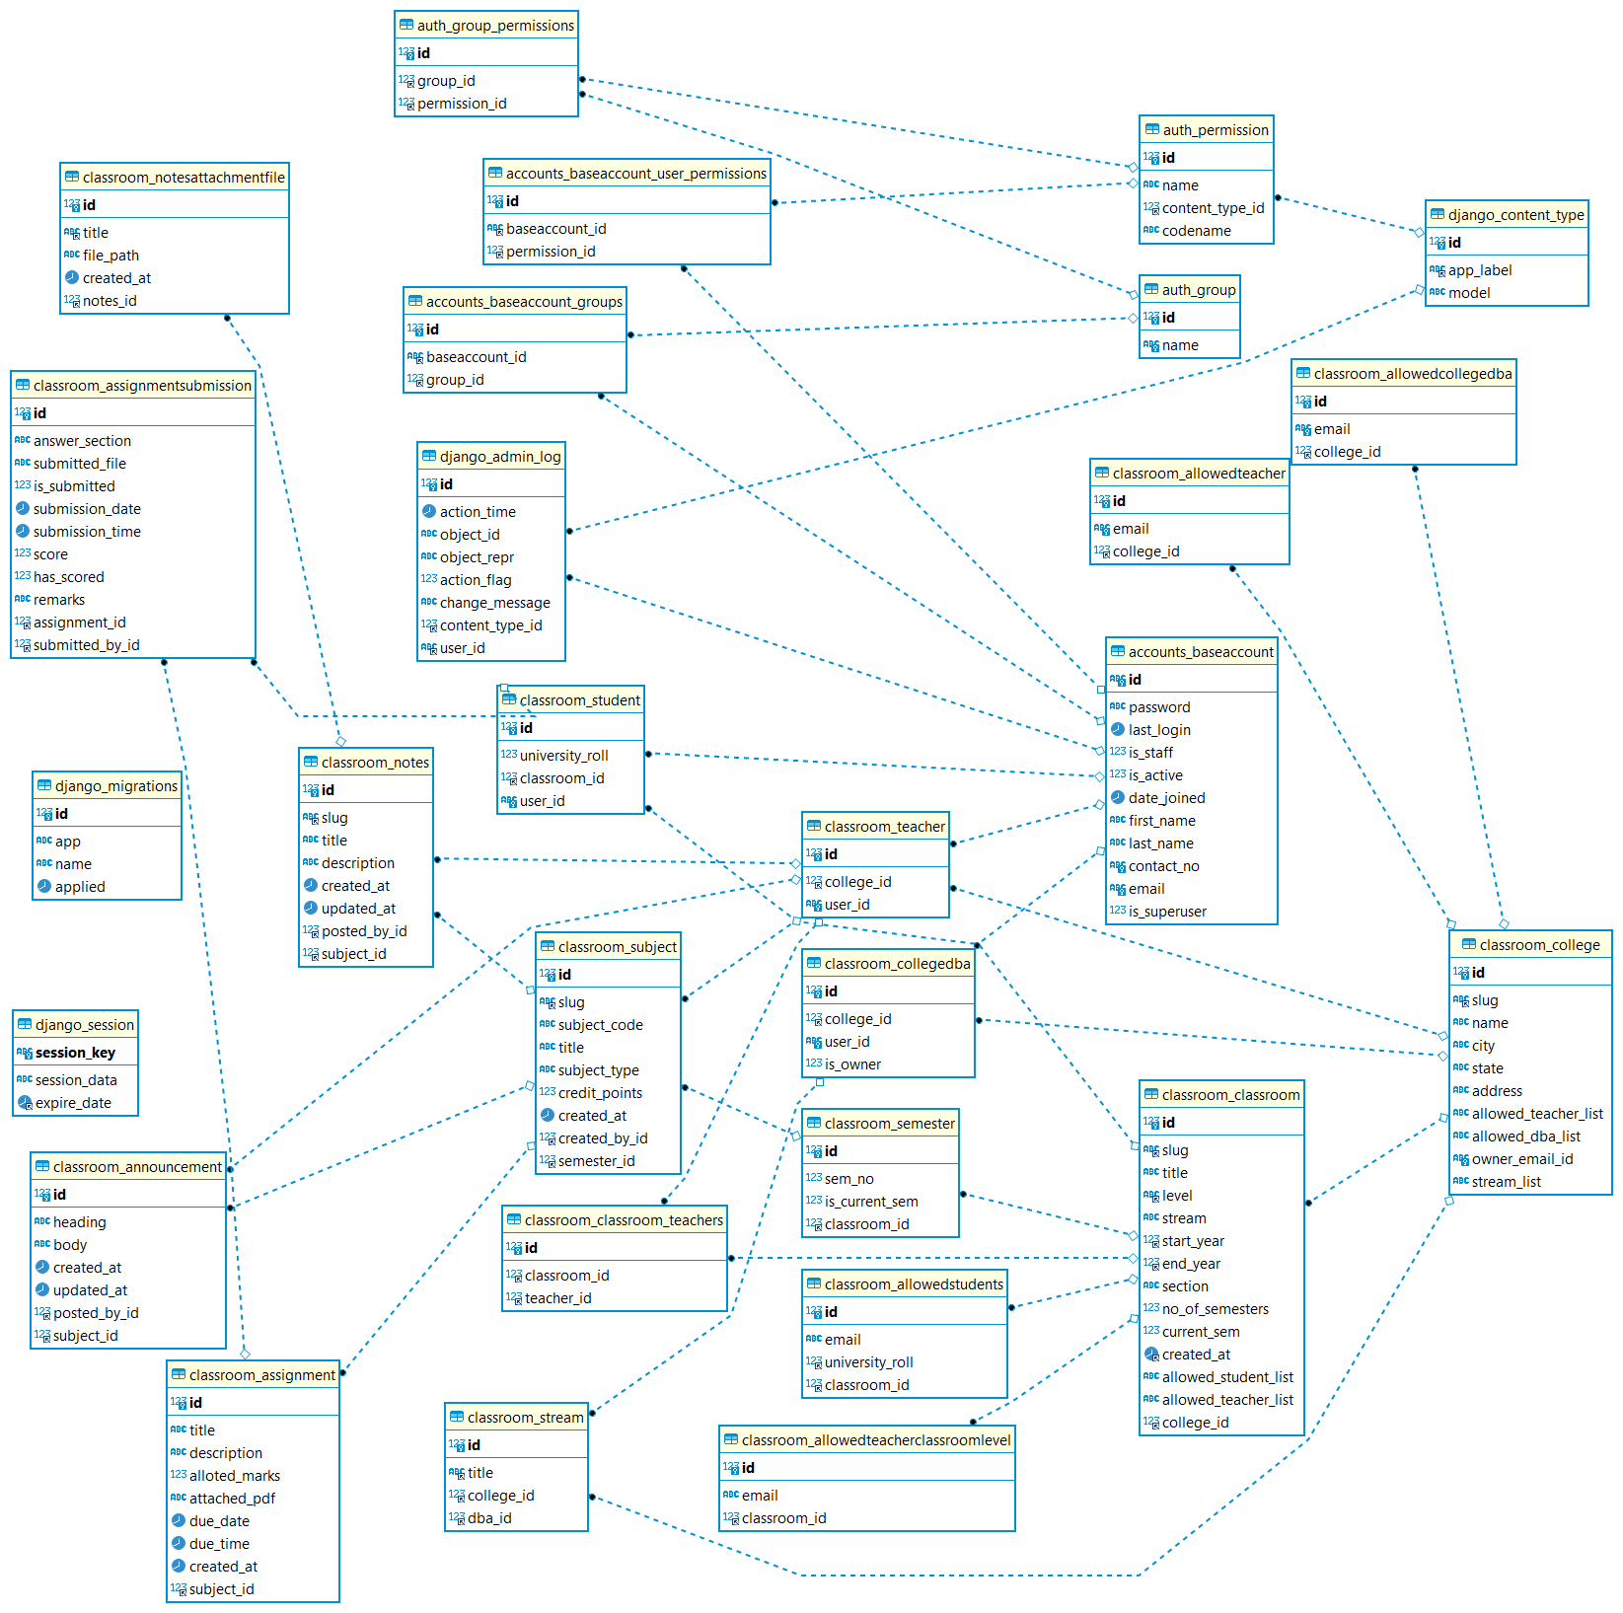

Slide 36
USE CASE DIAGRAM

Slide 37
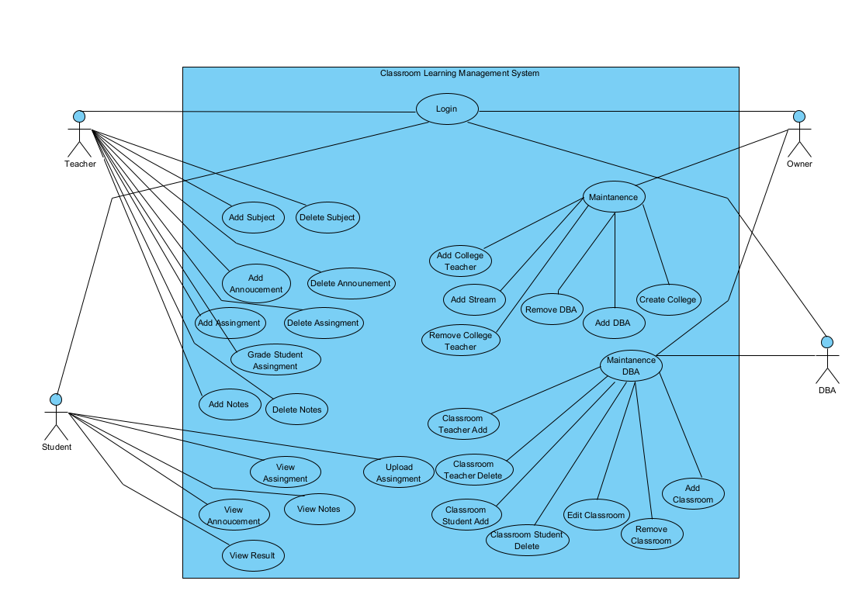

Slide 38
Future Scope

Slide 39
What we look for future…
Quiz
Comment
Routine
Quiz and examination system will be added along with assignments in the LMS in future
Comment option will be added on an announcement posted by teachers so that students can post their queries there
Class routine format will be added for both teachers and students
Calendar
Will be in school
Focus UI
Calendar feature will be added so that teacher and students can follow the upcoming events by the system
Not only on college system but also the school system can use the Classroom LMS in future. More depth work is needed for that
Modify the user interface and incorporate tiny features to give better user experience

Slide 40
Conclusion

Slide 41
Successfully created Virtual Learning Management System by maintaining the college.
Integrated all the administrations, teachers and students under a single umbrella.
Students can update their own data.
Teachers will visualize all of their classrooms on their dashboard.
Administrators will create classrooms, assign teachers and students to a Classroom.
DBAs update classroom-related details and semester details.

Slide 42
Avail features like subject creation, class announcements, add notes.
User profile updation, ongoing semester badge, assignments grading method
Downloadable notes publish,feedback result etc.

Slide 43
Do you have any questions?

Slide 44
Thanks!

